Slide 1
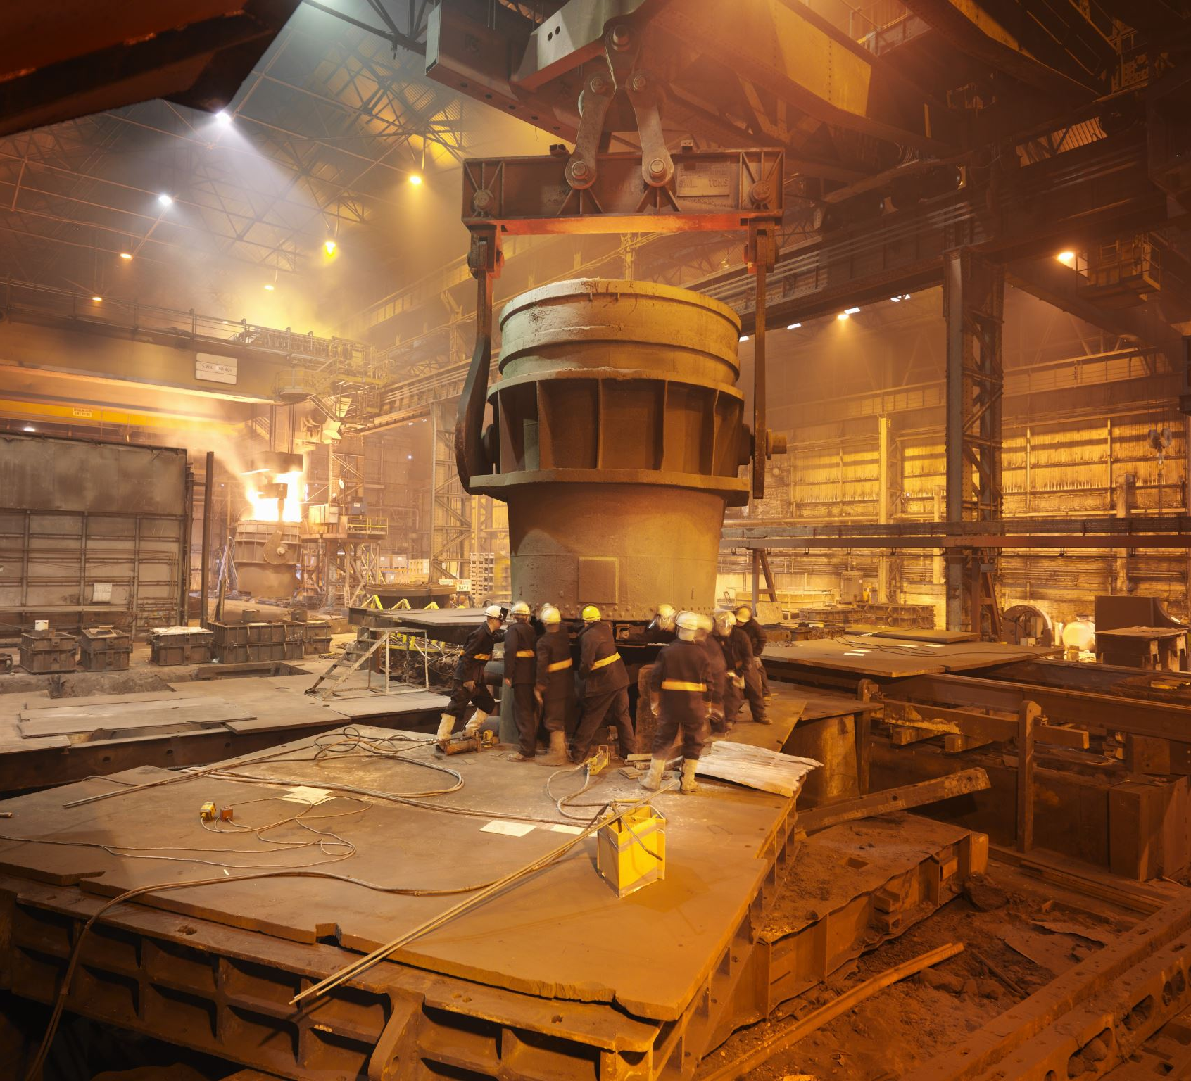
ME 310 Project :
HEAT TRANSFER EQUIPMENT DESIGN

Slide 2
Submitted By :
MD. FARHAN (1710035)
MD SHAHED HOSSAIN SOHAN (1710043)
ABU HANIFA (1710044)
MEHEDI HASAN (1710060)

Slide 3
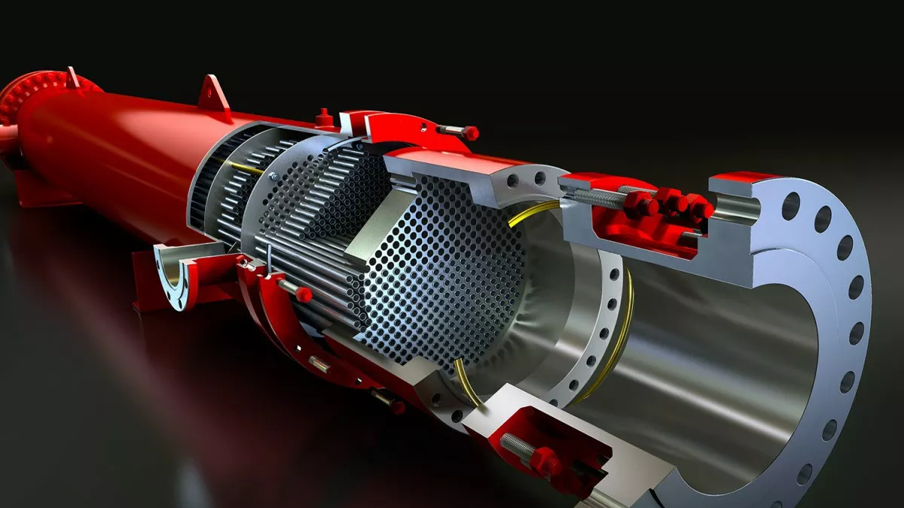
Shell & Tube HX with Helical Baffle

Slide 4
Abstract
In the present study, three-dimensional numerical simulation of shell-and-tube heat exchangers (STHXs) with continuous helical baffle (STHXsHB) is carried out and is performed based on the simulation results.
The STHXs contain 25 tubes inside a 500 mm long and 200 mm diameter shell and mass flow rate of shell-side fluid is varied from .3 kg/s to .4 kg/s. At first, physical and mathematical models are developed and numerically simulated using finite element method (FEM).

Slide 5
Abstract
For the validation of the computational model, shell-side average nusselt number (Nus) is calculated from the simulation results and compared with the available experimental results. The comparative study shows that STHXsHB has 72-127% higher heat transfer coefficient per unit pressure drop compared to the conventional STHXsSB for the same shell-side mass flow rate. Moreover, STHXsHB has 59-63% lower shell-side pressure drop than STHXsSB.

Slide 6
Introduction
Heat exchangers are an inseparable part of industries such as power plants, process industries, oil refining and so on. Meanwhile, Shell and Tube Heat Exchangers (STHX) have 40% share apparatus of different industries. So, focusing on this type of heat exchangers to improve the performance has a great importance. Baffles and tube configuring have profound effect on the performance of shell and tube heat exchangers. Common segmental baffles can be referred but they have such problems like: creation of dead zones, decreasing the lifetime of the heat exchanger by creating vibration caused by fluid flow across tube bundle. Researches have been done for different baffle shapes, configurations and tube arrays i.e. triangular, square pitch etc.

Slide 7
Introduction
Baffles have been used of numerous shapes i.e. segmental, double segmental, helical, segmental-helical, flower shaped etc. In this study, numerical observation has been conducted on shell and tube heat exchanger with helical baffles. These type of baffles are introduced to remove the defects of segmental baffles. Literature review shows that When traditional segmental baffles are used in shell and tube heat exchanger, higher pumping power is often needed to offset higher pressure drop under same heat load. The problems of segmental STHX mentioned above were improved or solved by helical baffles.

Slide 8
Problem Statement
In this project, a shell and tube heat exchangers’ heating efficiency has been increased for a lower pressure drop than the conventional segmental baffles. In the shell side, hot fluid was entered and cold fluid passed through the tubes. This is a CFD approach.

Slide 9
Objectives
To design a efficient shell and tube heat exchanger with helical baffle.
To reduce the pressure drop for both shell side and tube side.
To reduce vibration by introducing continuous shell side fluid.

Slide 10
Hand Calculation Results
 | Shell side (Hot fluid-Water) | Tube side (Cold fluid-Water)
Inlet Temperature | 90C | 15C
Outlet Temperature | 83C | 22C
Dimensions | Shell side (Hot fluid-Water) | Tube side (Cold fluid-Water)
Inner dia, mm | 254,5 | 15.7
Outer dia, mm | 273.1 | 19.05
N_{t} | 25
Tube orientation | Triangular
Pitch, mm | 25.4

Slide 11
Hand Calculation Results
Dimensions | Shell side (Hot fluid-Water) | Tube side (Cold fluid-Water)
Inner dia, mm | 254,5 | 15.7
Outer dia, mm | 273.1 | 19.05
N_{t} | 25
Tube orientation | Triangular
Pitch, mm | 25.4
Pitch ratio | 1.33
Hydraulic dia, mm | 183 | 15.7
Baffle helix angle | 32.5
Number of turns | 1
Flow type | Turbulent | Turbulent

Slide 12
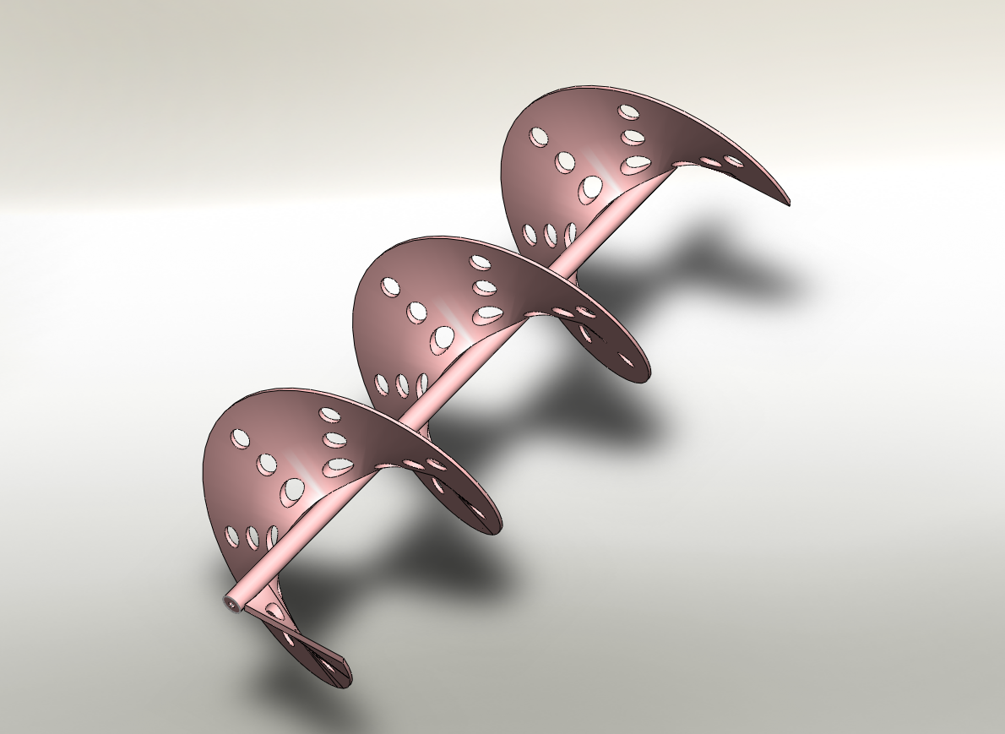
Design strategy
Solidworks model
Figure: Helical Baffle

Slide 13
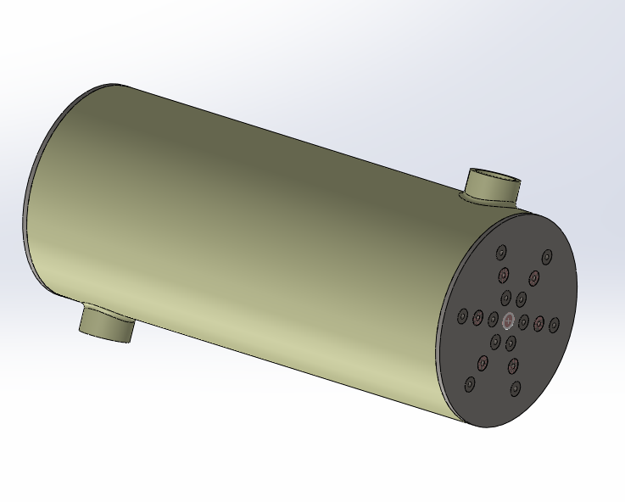
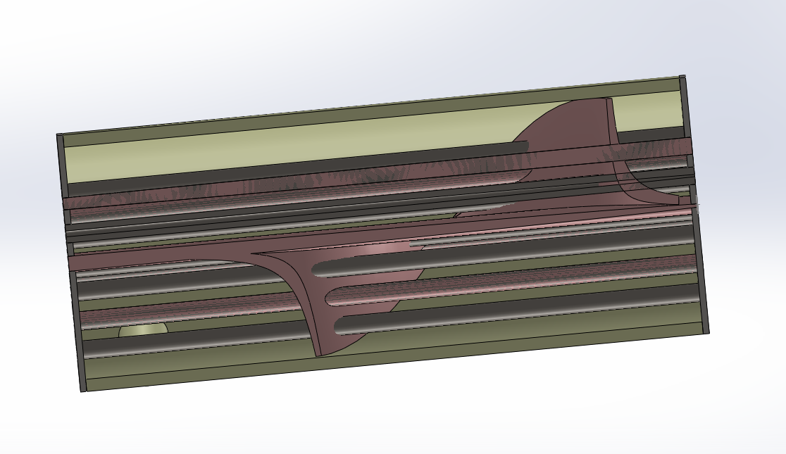
Design strategy
Solidworks model
Figure: Shell and tube heat exchanger whole and sectional view

Slide 14
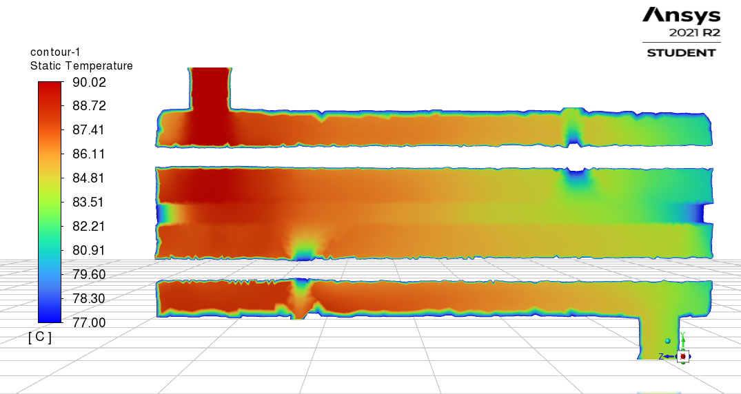
Design Model
Figure : Shell Fluid Temperature Contour

Slide 15
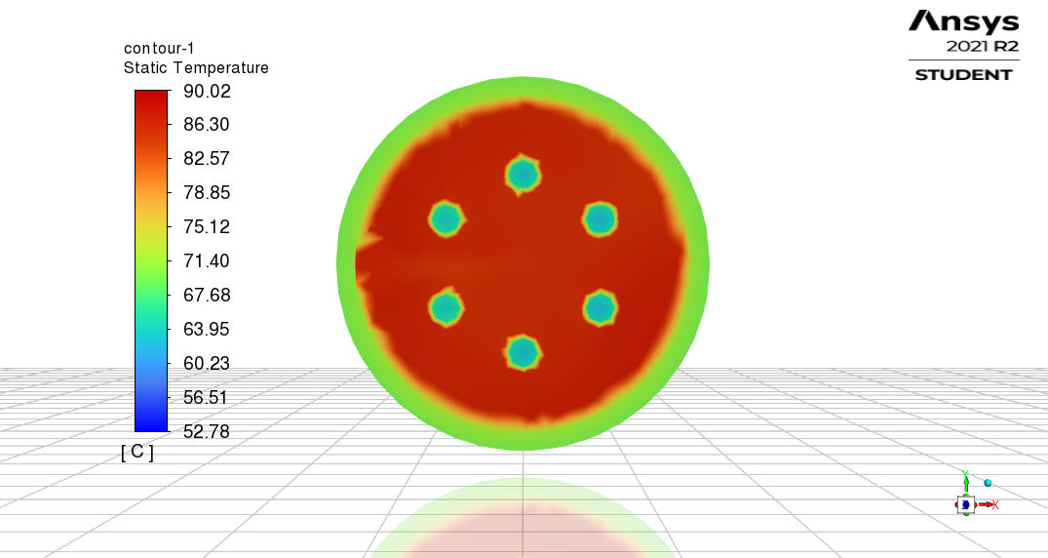
Design Model
Figure: Temperature Contour (XY plane)

Slide 16
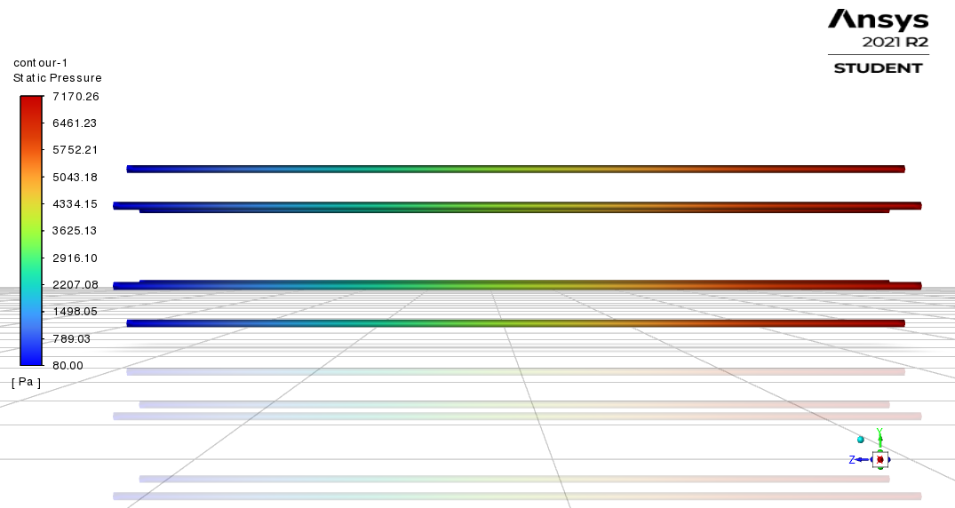
Design Model
Figure: Tube Fluid Pressure Contour

Slide 17
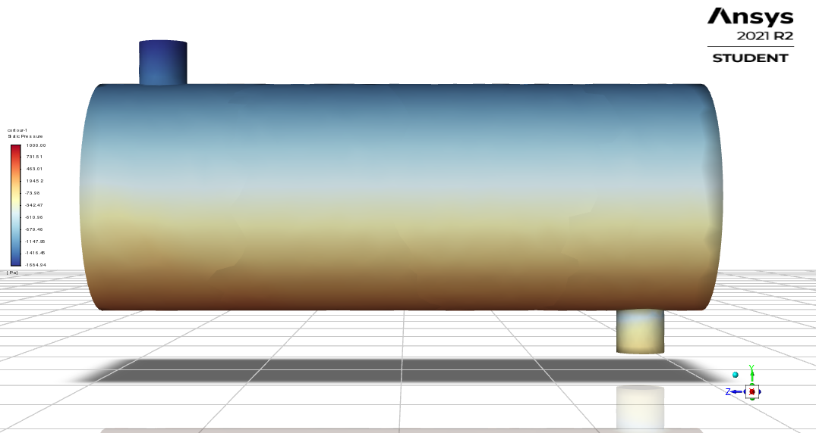
Design Model
Figure: Shell Fluid Pressure Contour

Slide 18
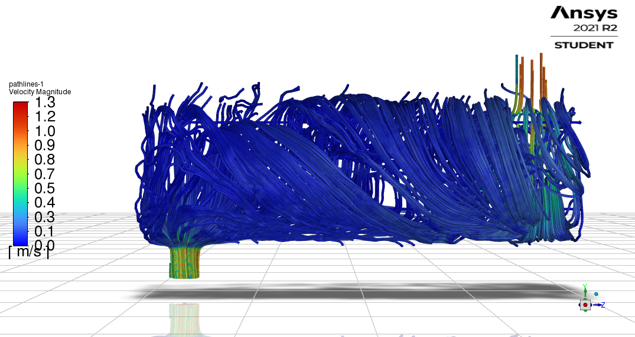
Design Model
Figure: Shell Fluid Velocity Profile

Slide 19
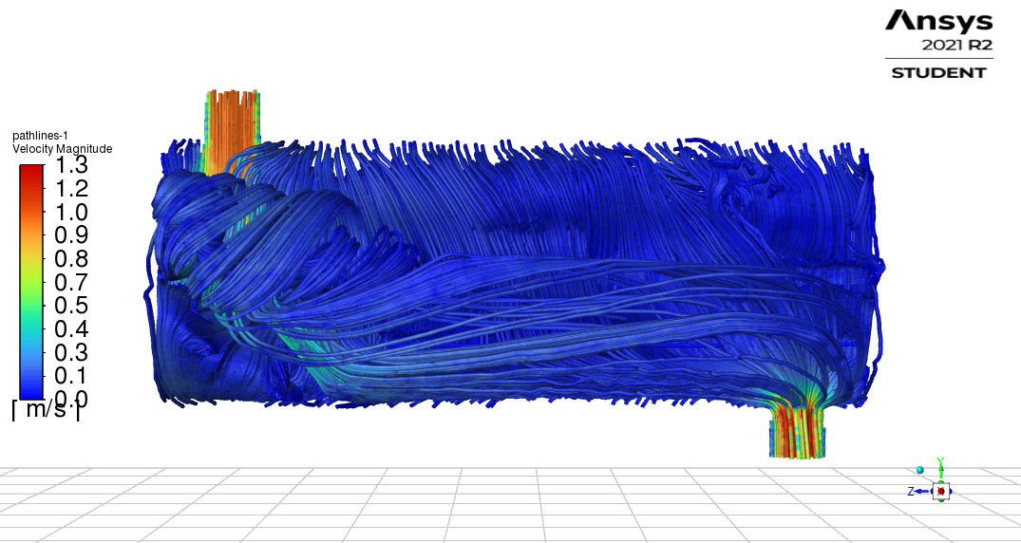
Design Model
Figure: Shell Fluid Velocity Profile

Slide 20
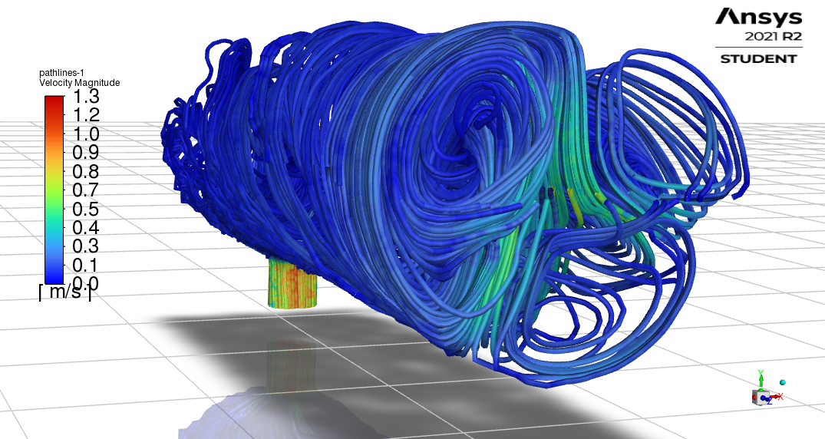
Design Model
Figure: Shell Fluid Velocity Profile

Slide 21
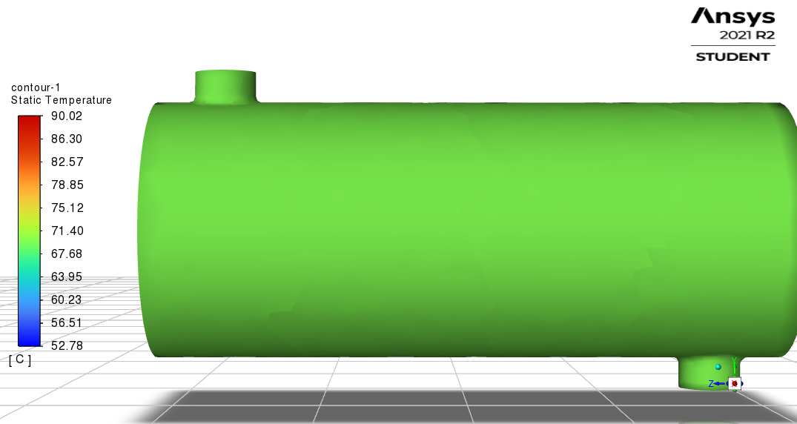
Design Model
Figure: Shell Wall Temperature

Slide 22
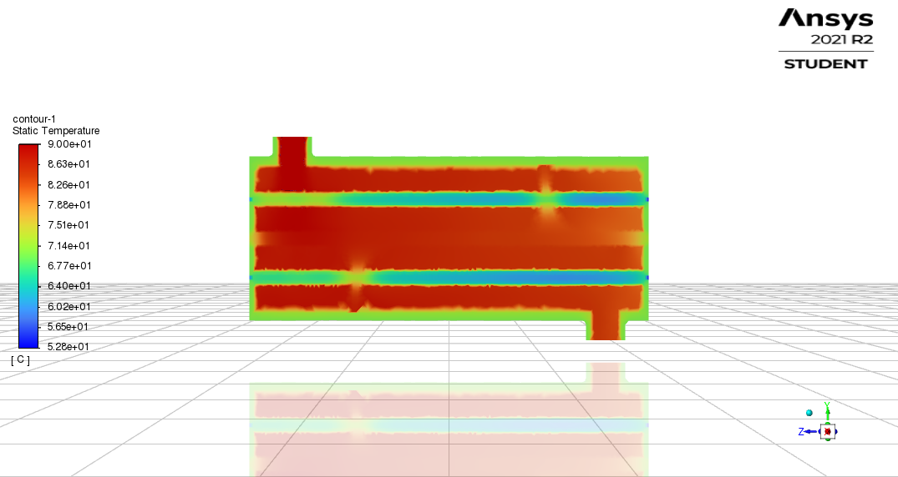
Design Model
Figure: Temperature Contour

Slide 23
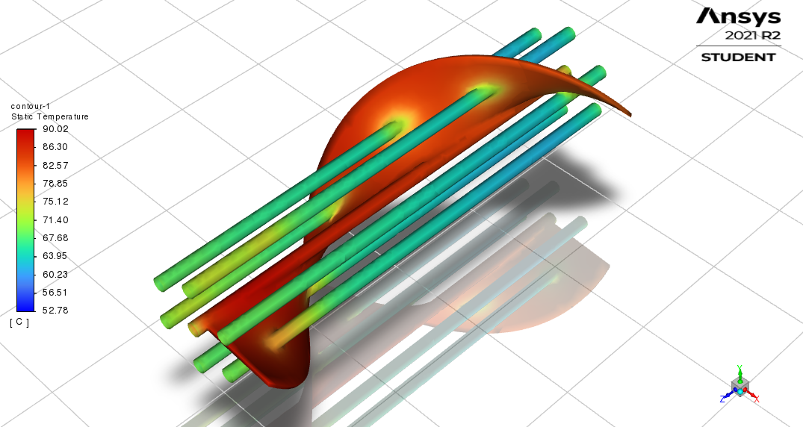
Design Model
Figure: Tube Wall and Baffle Temperature (Isometric View)

Slide 24
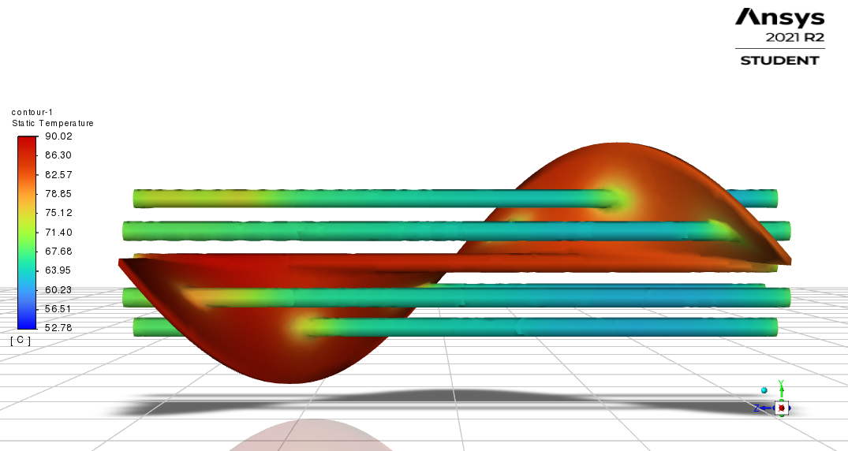
Design Model
Figure: Tube Wall and Baffle Temperature (Front View)

Slide 25
Simulation
VELOCITY FLOW

Slide 26
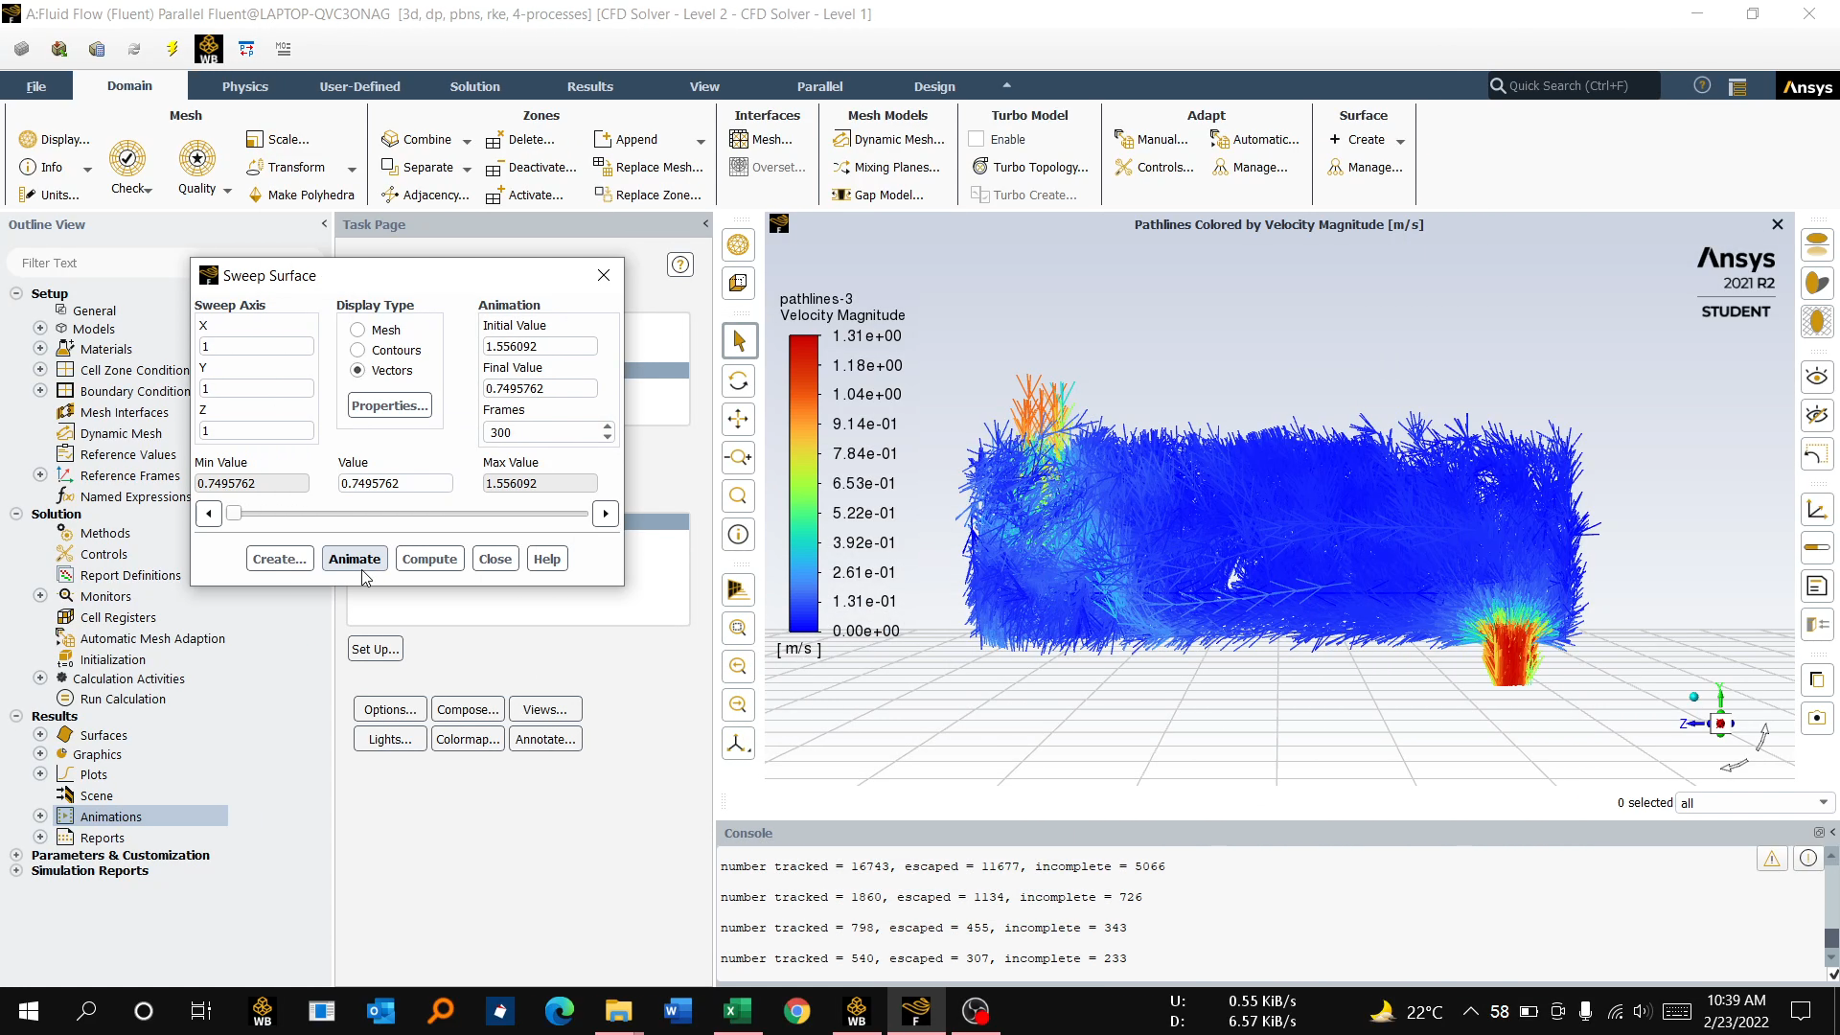
Simulation

Slide 27
Simulation
VELOCITY FLOW WITH TEMPERATURE CONTOUR

Slide 28
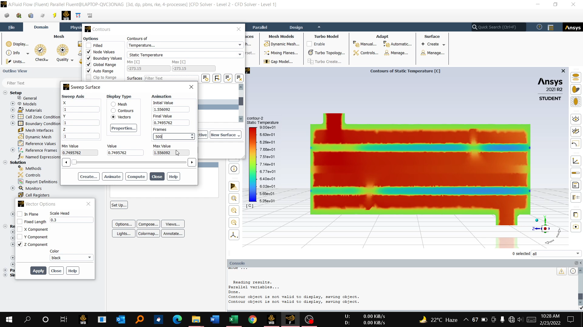
Simulation

Slide 29
HTRI CALCULATION

Slide 30
Output Summary ^{Page 1} Released to the following company: Heat Equipment Designer Mehedi Hasan
Xist 7.3.2 2/23/2022 11:26 SN: 46639- ^{SI Units} Rating - Horizontal Countercurrent Flow TEMA AES Shell With Single helical Baffles
See Data Check Messages. See Runtime Messages.
Process Conditions Hot Shellside |  |  | Cold Tubeside
Fluid name Water |  |  | water
Flow rate (kg/s) 0.3000 |  |  | 1.6500
Inlet/Outlet Y (Wt. frac vap.) 0.0000 0.0000 |  |  | 0.0000 0.0000
Inlet/Outlet T (Deg C) 90.00 77.00 |  |  | 15.00 17.37
Inlet P/Avg (kPa) 0.000 0.000 |  |  | 0.000 0.000
dP/Allow. (kPa) 6.23 70.000 |  |  | 1.958 70.000
Fouling (m2-K/W) 0.000090 |  |  | 0.000090
Exchanger Performance
Shell h (W/m2-K) 879.59 |  | Actual U (W/m2-K) 583.48
Tube h (W/m2-K) 4421.8 |  | Required U (W/m2-K) 529.23
Hot regime (--) Sens. Liquid |  | Duty (MegaWatts) 0.0164
Cold regime (--) Sens. Liquid |  | Eff. area (m2) 0.461
EMTD (Deg C) 67.2 |  | Overdesign (%) 10.25
Shell Geometry |  | Baffle Geometry
TEMA type (--) ^{AES} |  | Baffle type Single Helical
Shell ID (mm) ^{200.00} |  | Helix angle (deg) 32.50
Series (--) ¹ |  | Baffle crossing fraction 0.0694
Parallel (--) ¹ |  | Central spacing (mm) ^{25.000}
Orientation (deg) 0.00 |  | Helical baffle sets (--) 1.0000
Tube Geometry |  | Nozzles
Tube type (--) Plain |  | Shell inlet (mm) ^{26.645}
Tube OD (mm) ^{12.700} |  | Shell outlet (mm) ^{26.645}
Length (m) ^{0.500} |  | Inlet height (mm) ^{24.909}
Pitch ratio (--) ^{1.2500} |  | Outlet height (mm) ^{24.909}
Layout (deg) ³⁰ |  | Tube inlet (mm) ^{52.553}
Tubecount (--) ²⁵ Tube Pass (--) 1 |  | Tube outlet (mm) ^{52.553}
Thermal Resistance, % | Velocities, m/s Min Max Tubeside 0.95 0.95 Crossflow 0.32 0.32 Window -- --
Shell 66.33
Tube 17.83
Fouling 12.35
Metal 3.49

Slide 31
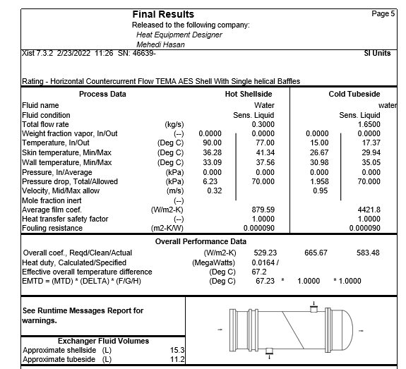

Slide 32
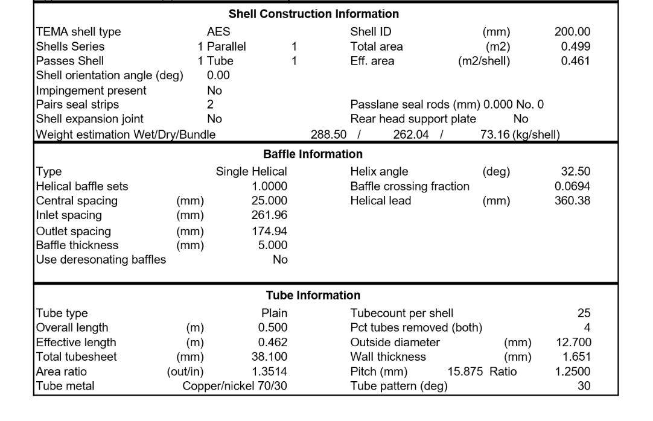

Slide 33
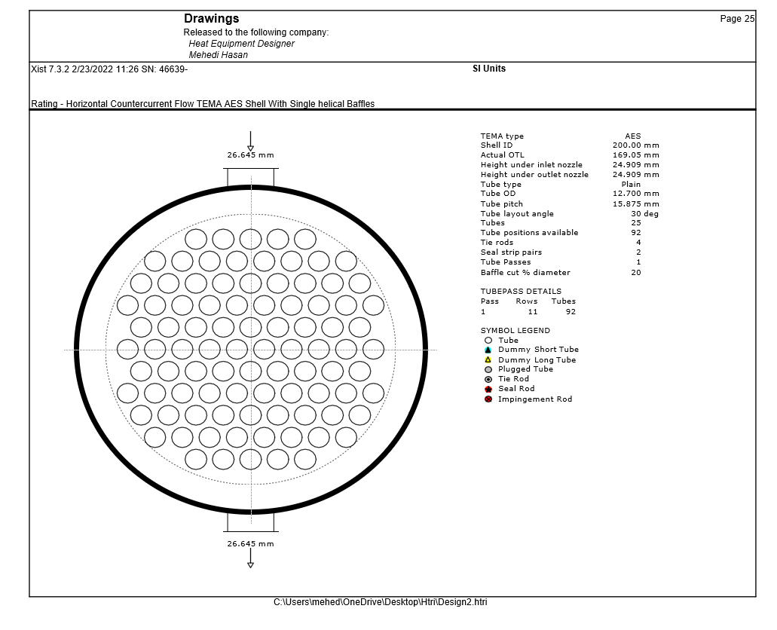

Slide 34
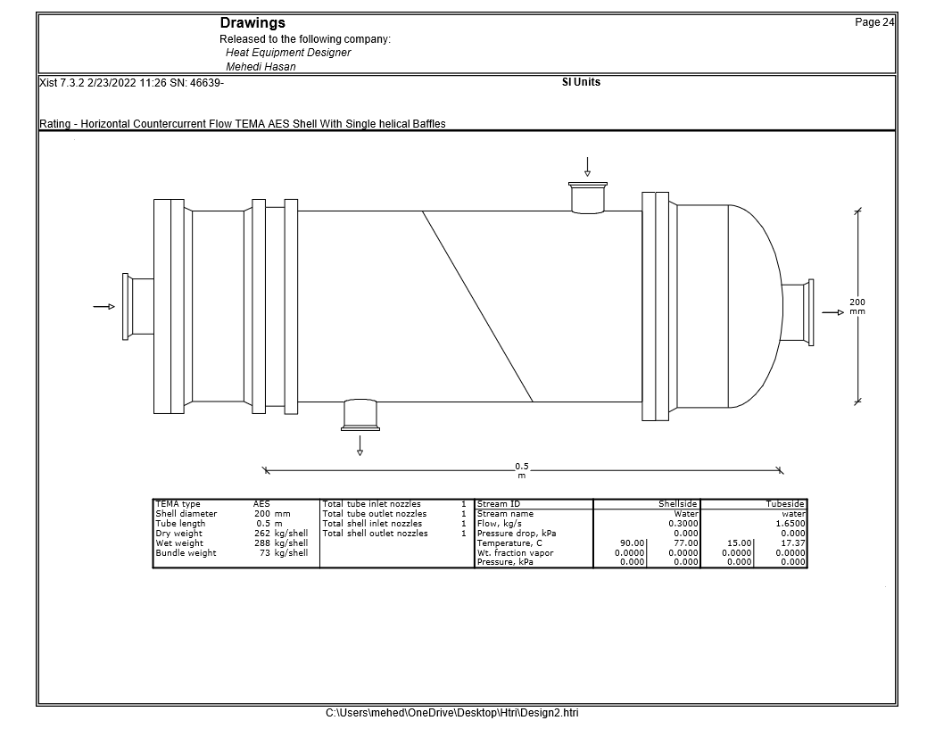

Slide 35
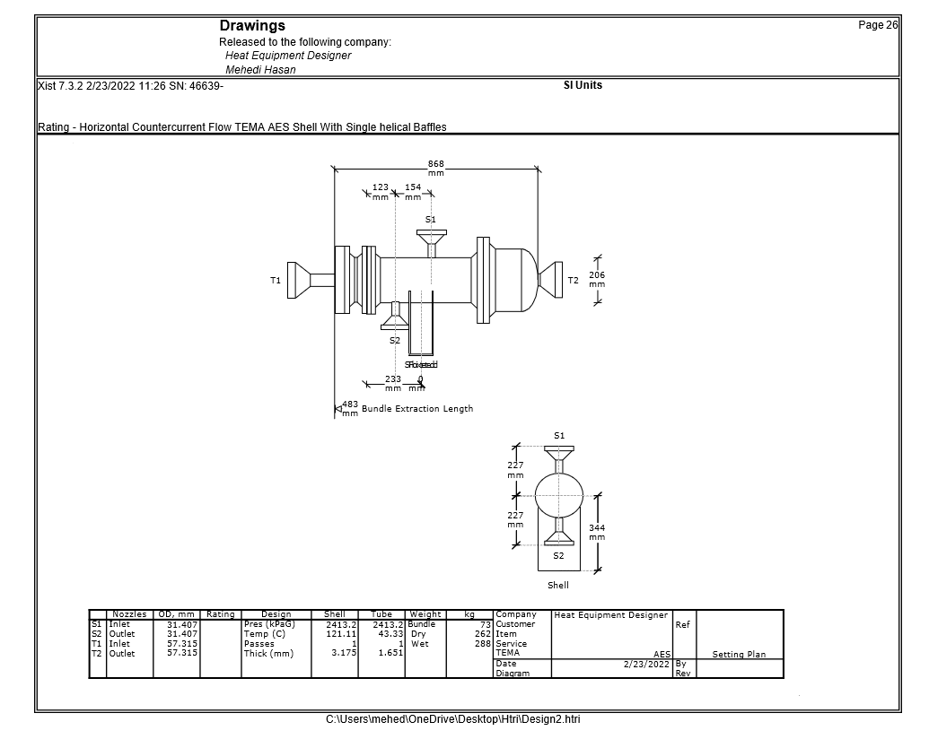

Slide 36
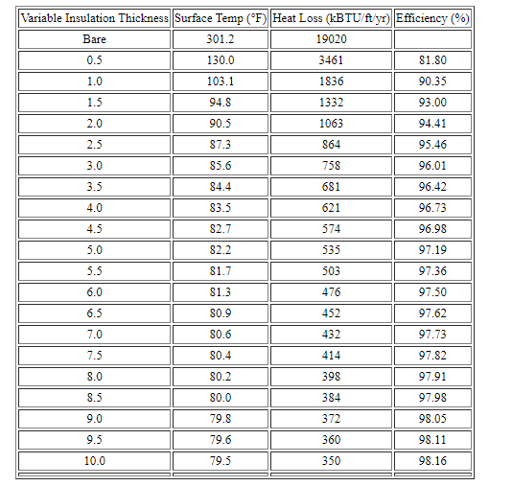
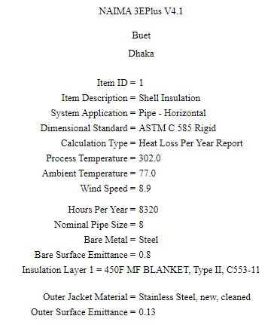
Economic consideration:

Slide 37
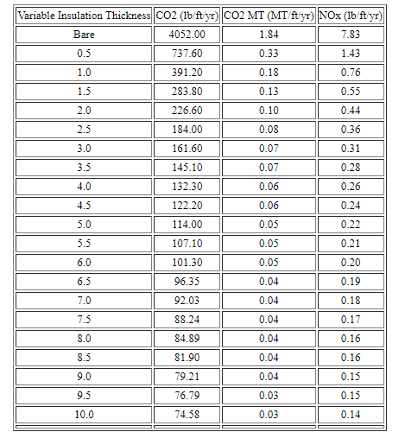
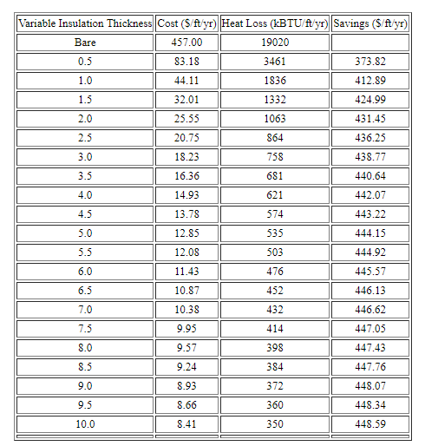
Economic consideration:

Slide 38
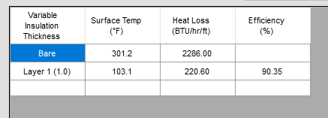
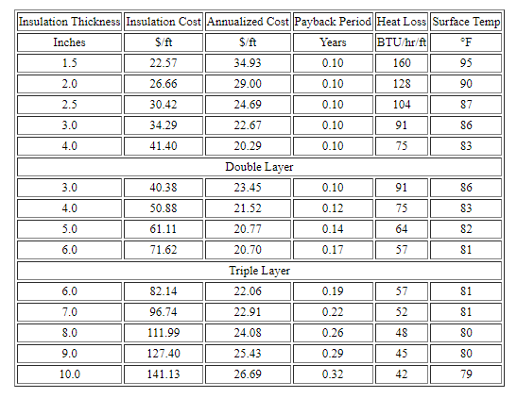
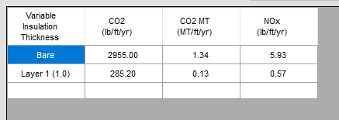
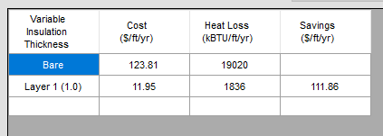
Economic consideration:

Slide 39
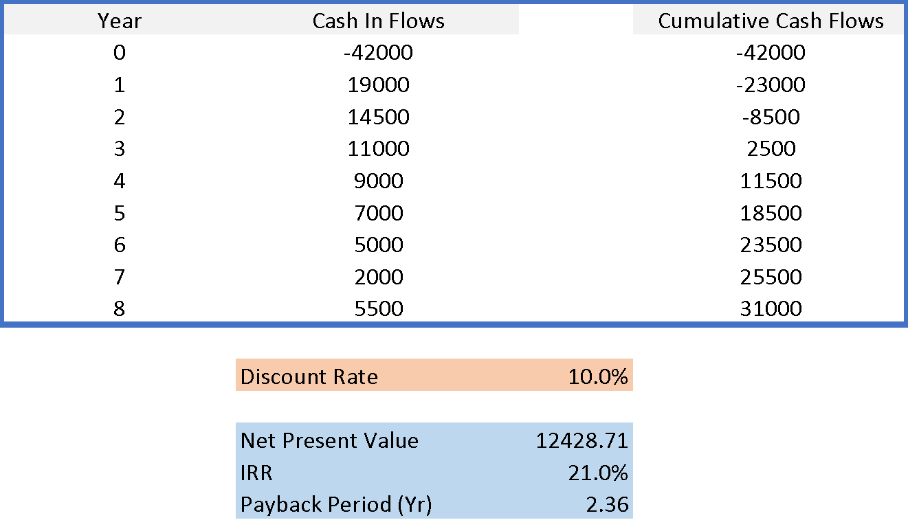
Economic consideration:

Slide 40
Final Results:
 | Shell side - Water | Tube side - Water
Outer Dia, mm | 18 | 12.7
Inner Dia, mm | 200 | 250
Length, mm | 1000 | 1000
N_{p} | 1 | 1
N_{t} |  | 25

Slide 41
Conclusion:
In this study, we tried to increase the heat transfer efficiency for a shell and tube heat exchanger adding helical shaped baffles. Our main objective was to increase heat transfer with lower pressure drop. From the calculation and simulation it is clear that the pressure drop was little for both shell fluid and tube fluid. This incurs lower pumping power to flow the fluid through shells and pipes. The helical baffles used here has made the flow more smoother and continuous. As we have simulated for a simplified baffle and tube geometry, there was some mismatch between the result from simulation and software calculation.

Slide 42
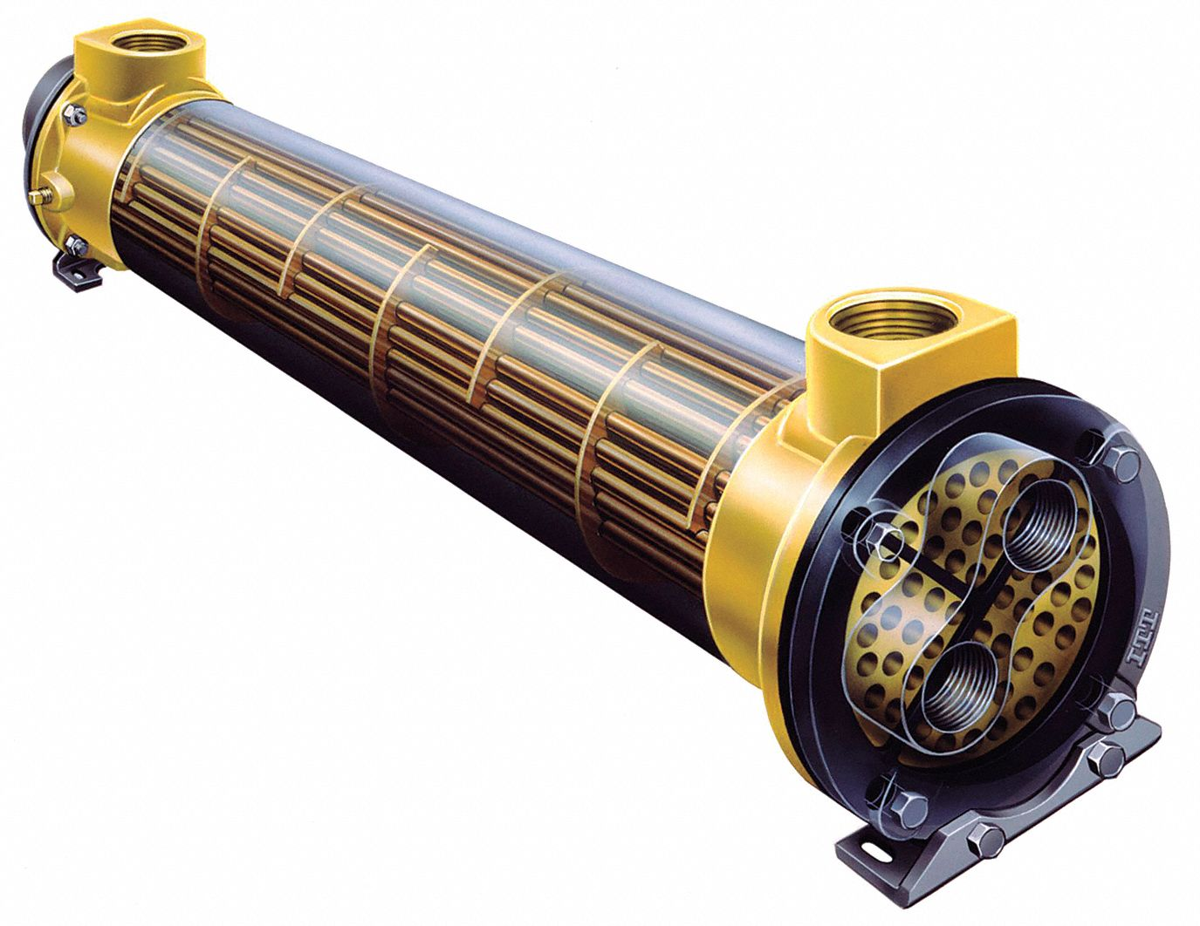
Thank You

